Slide 1
SUBWAY INFRASTRUCTURE vs. HOUSING CONSTRUCTION in Brooklyn Presented to MTA
Group 7
Matt Buck
Pavel Dekhman
Matthew Mollerus
Allen Qu
Dan Roth

Slide 2
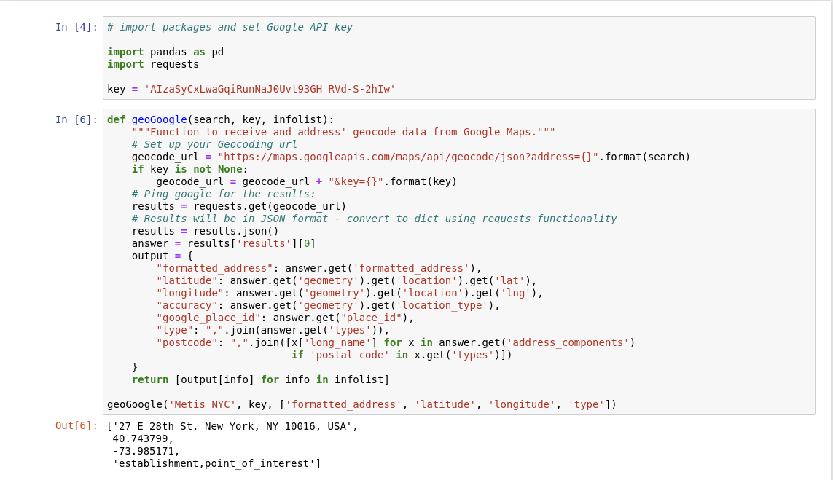
Locating MTA Subway Stations

Slide 3
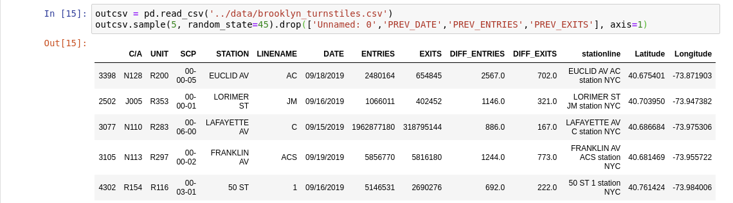
Processing Dataframe

Slide 4
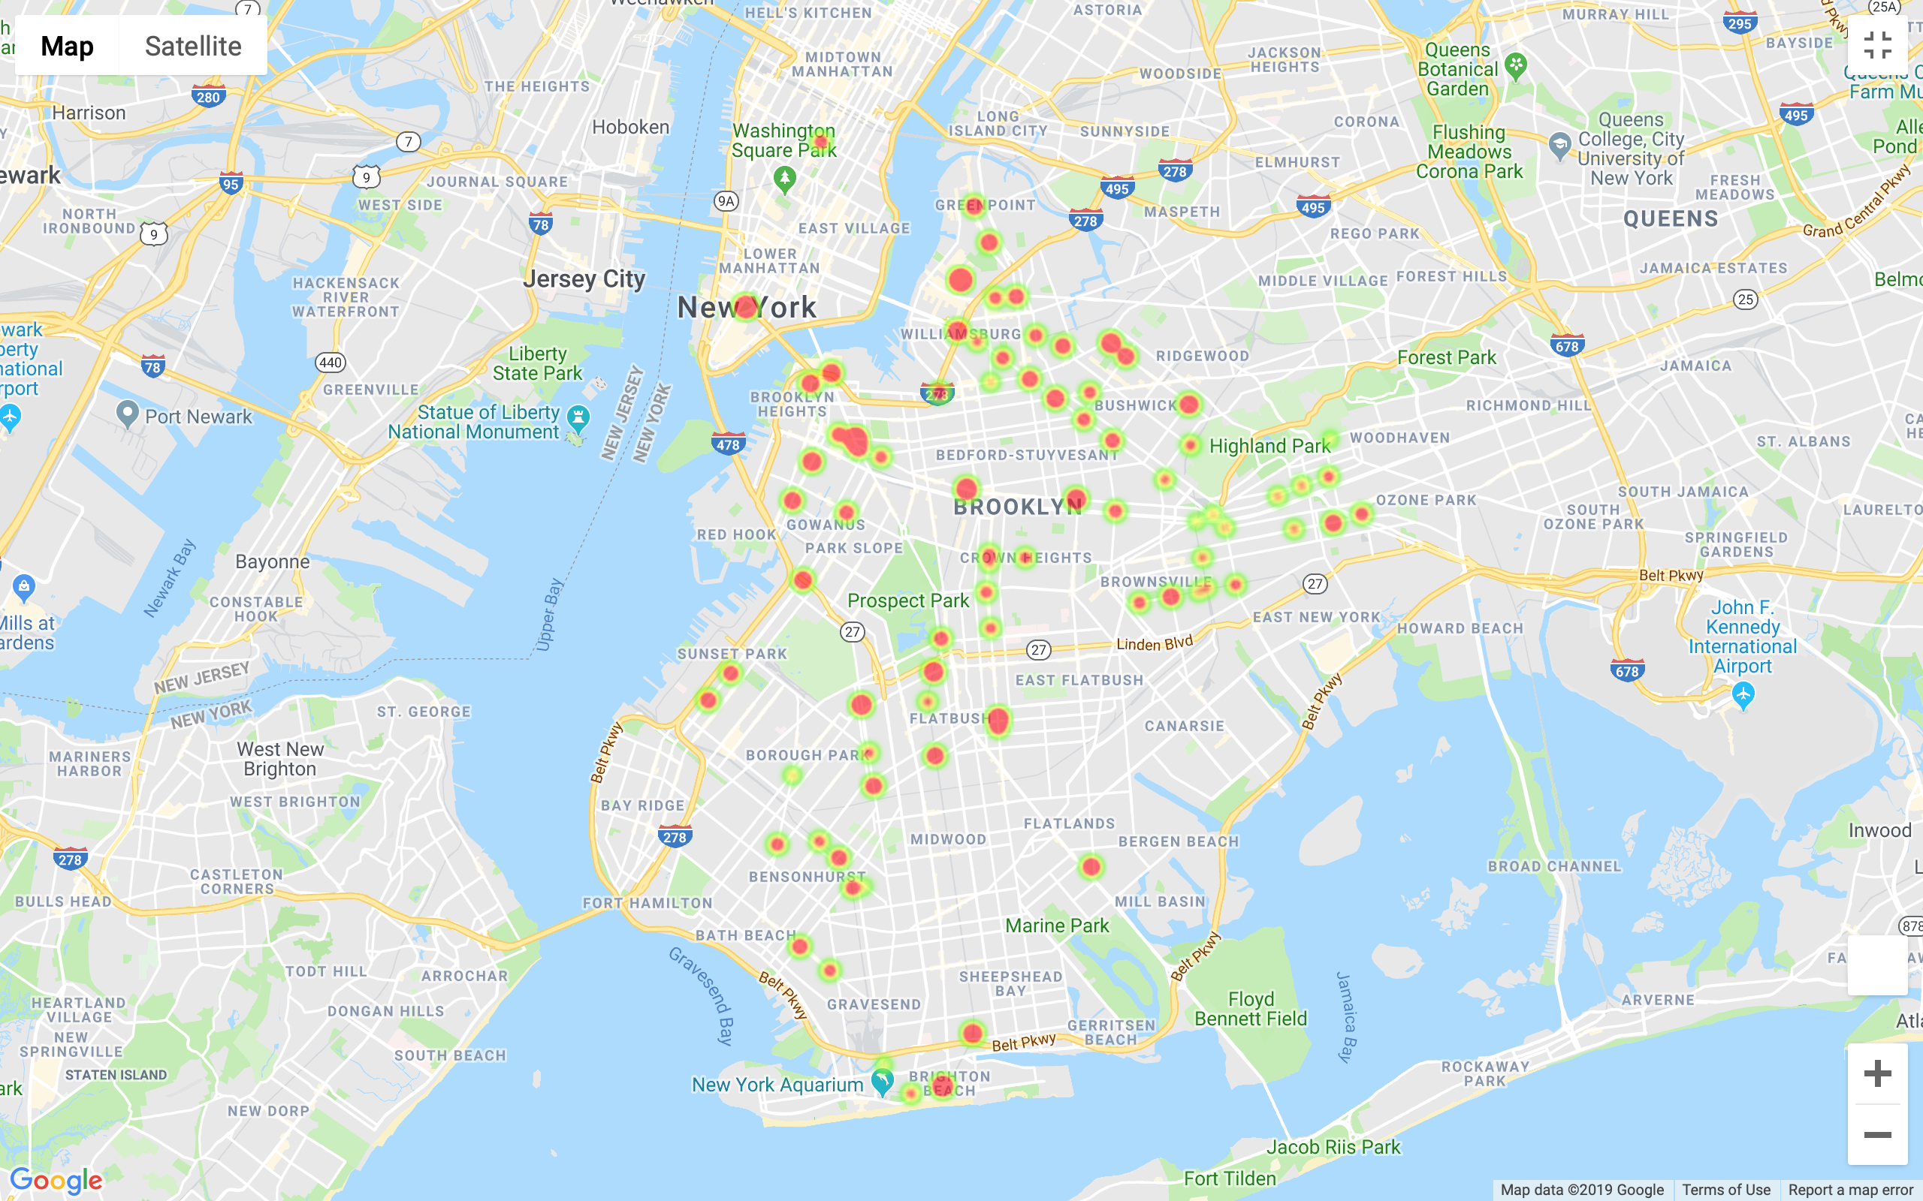
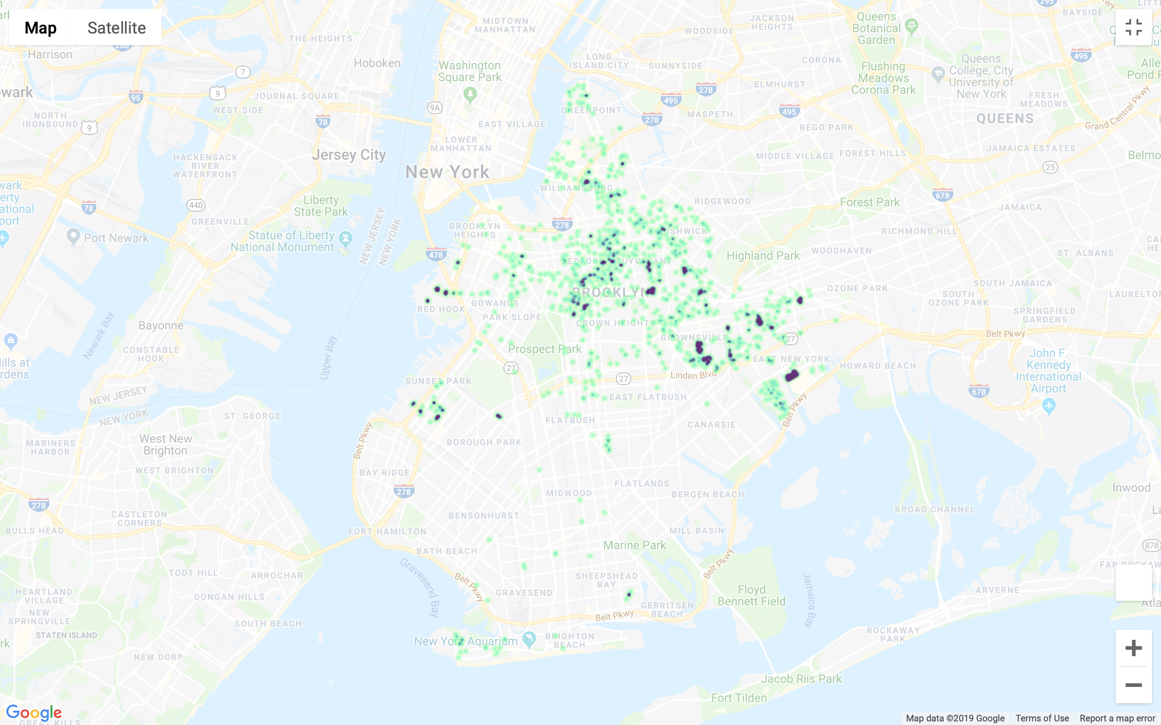
Visualizations
Daily Entry Density by MTA Station
New Construction Units Density
Low Density
Low Density
High Density
High Density

Slide 5
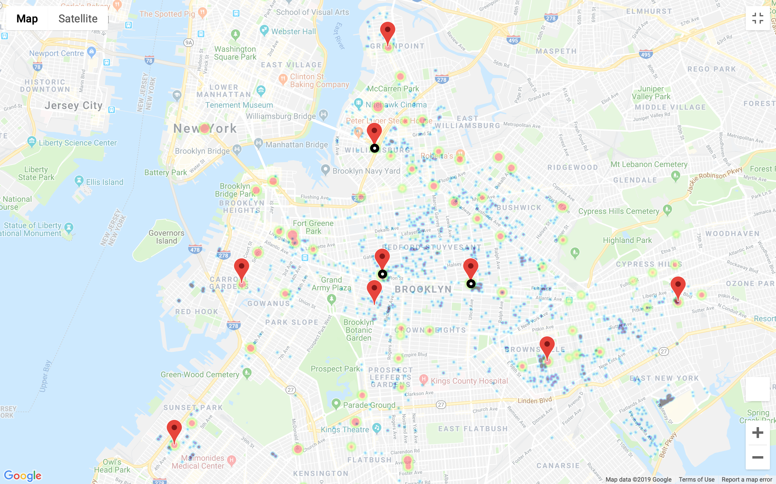

Results
Daily Entry Density by MTA Station
Low Density
High Density
New Construction Units Density
Low Density
High Density
Stations with High MTA Entries and Construction Density
Focus Stations

Slide 6
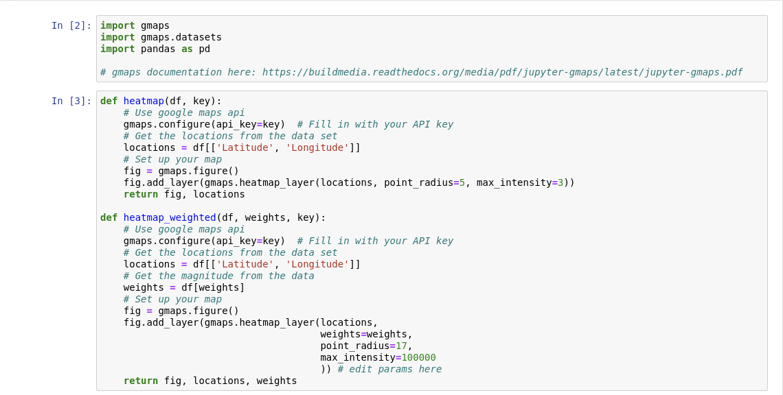
Generating Heatmaps

Slide 7
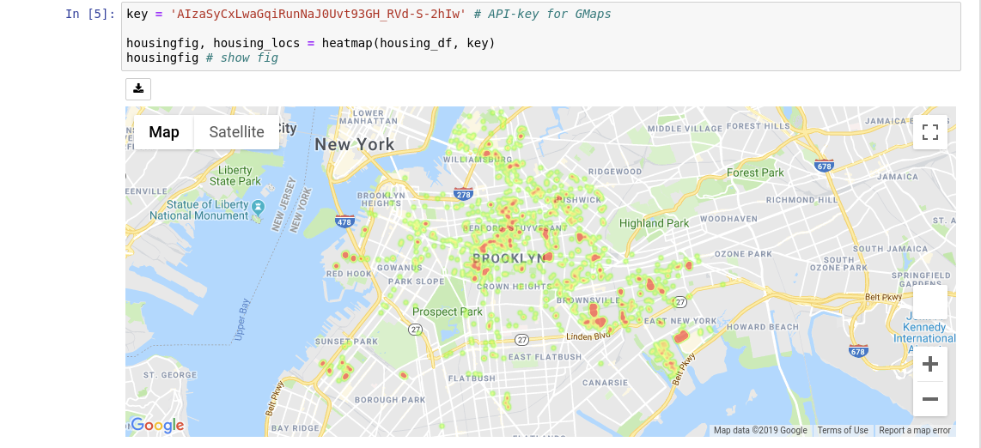

Slide 8
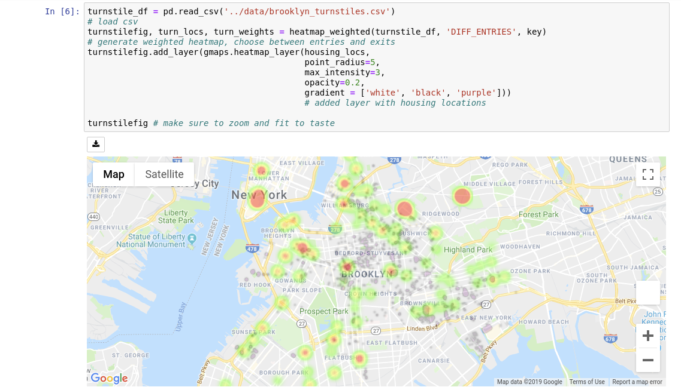

Slide 9
Future Work
Better way to differentiate duplicate station names
Borough delineation

